Slide 1
Pandas

Slide 2
Series
A series is a data structure in Pandas that holds an array of information along with named index
The named index differentiates this from a simple NumPy array
Formal definition: One-dimentional ndarray with axis labels

Slide 3
Numpy array has a numeric index
Index | Data
0 | 1776
1 | 1867
2 | 1821

Slide 4
Pandas series adds on a labelled
Labelled Index | Data
USA | 1776
CANADA | 1867
MEXICO | 1821
It is easier to user than to memorize the index locations

Slide 5
Data is still numerically organized
Numeric Index | Labelled Index | Data
0 | USA | 1776
1 | CANADA | 1867
2 | MEXICO | 1821
The data can be captured through the numeric index call or the labelled index call in the Pandas series to get
the best of both worlds

Slide 6
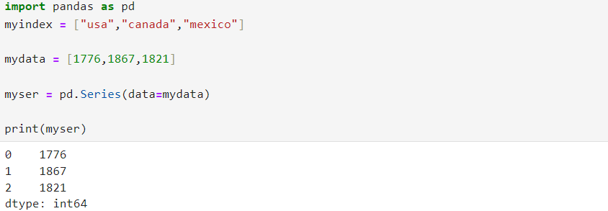
Creating Pandas series

Slide 7
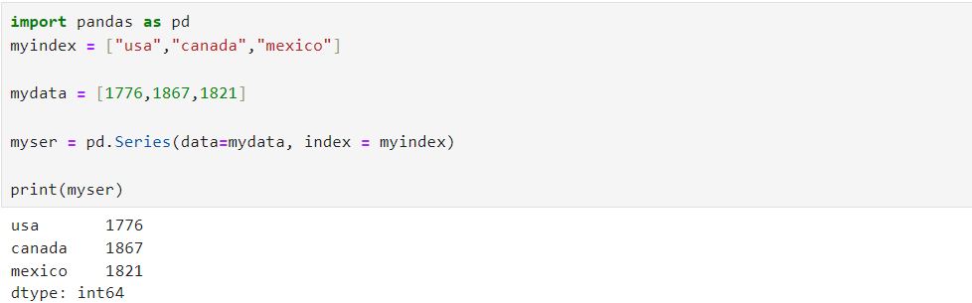

Slide 8
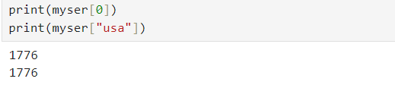

Slide 9
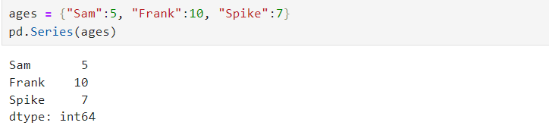
Creating series from a dictionary

Slide 10
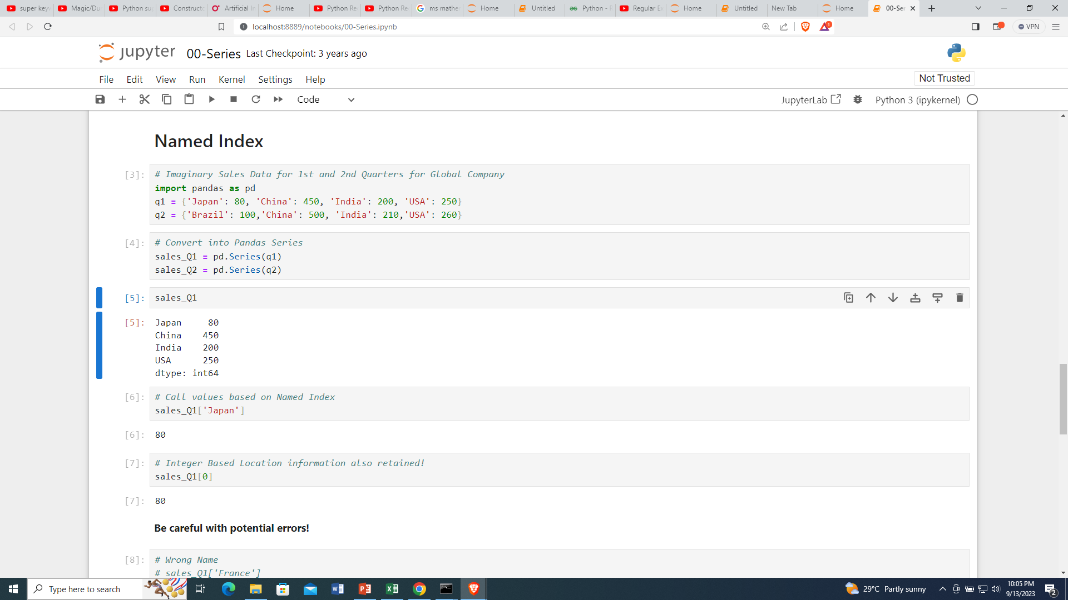
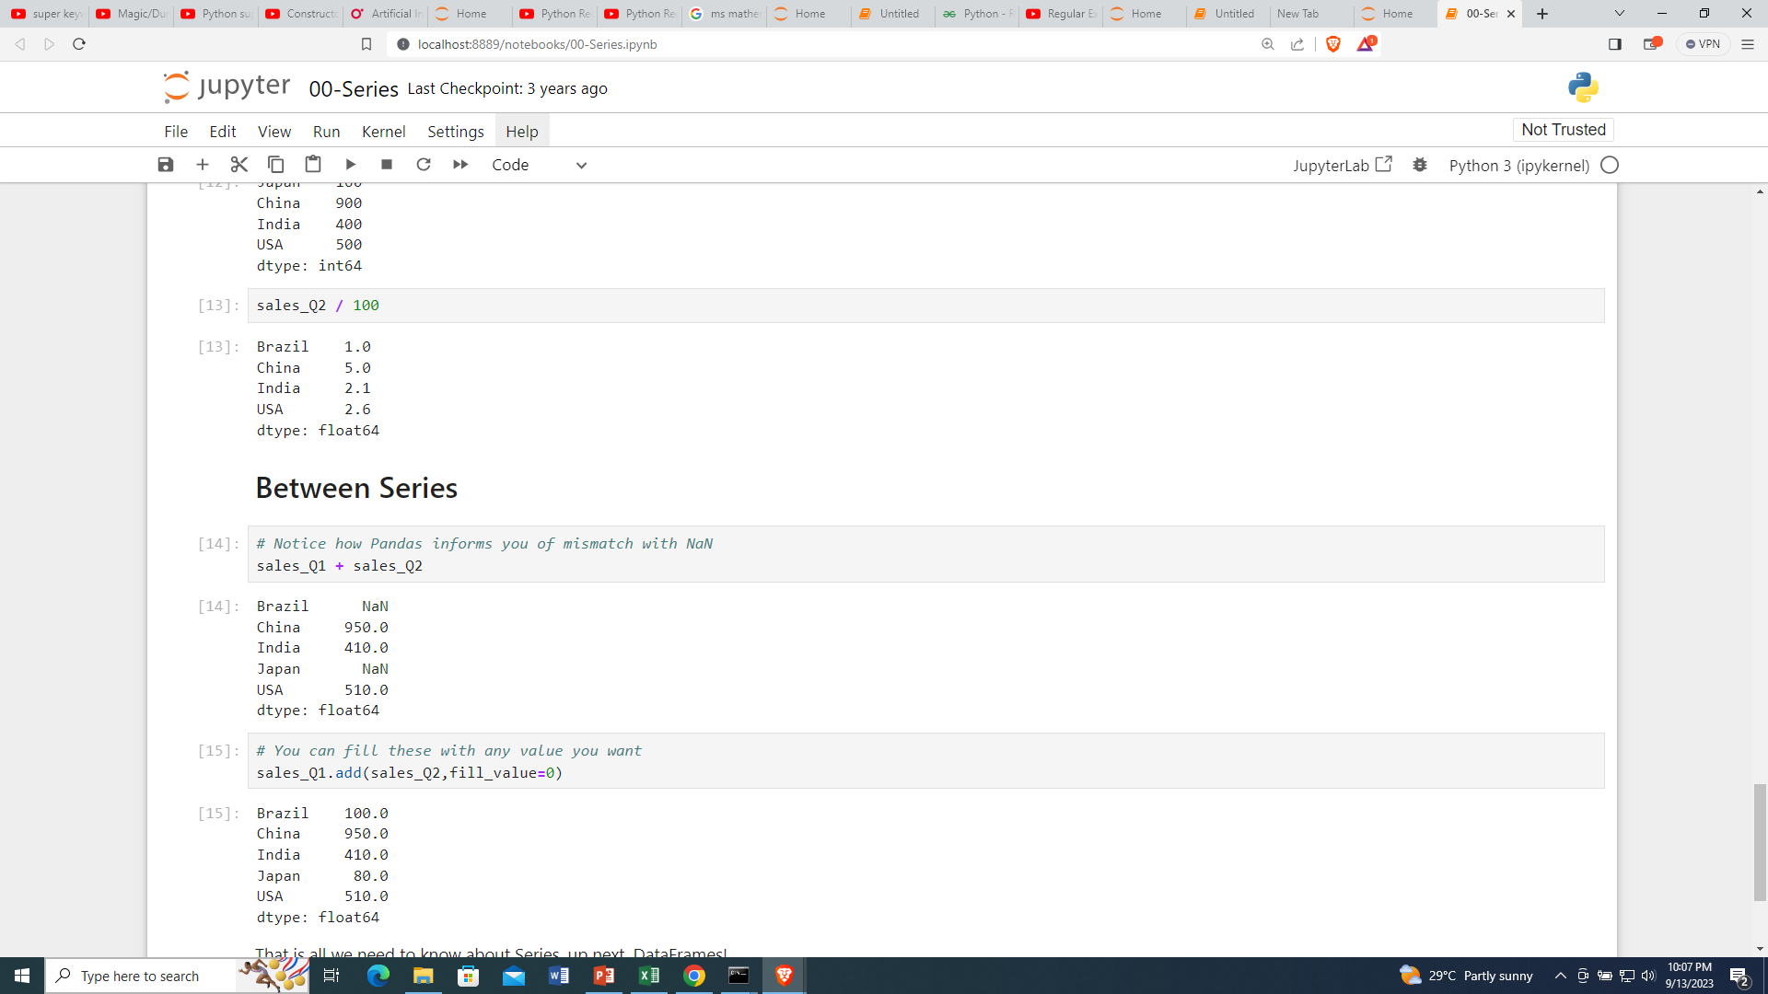
Operations on series
Add q1 and q2

Slide 11
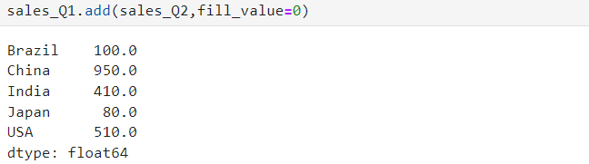

Slide 12
Dataframes
A DataFrame is a table of columns and rows in pandas that we can easily restructure and filter
Formal definition: A group of Pandas Series objects that share the same index

Slide 13
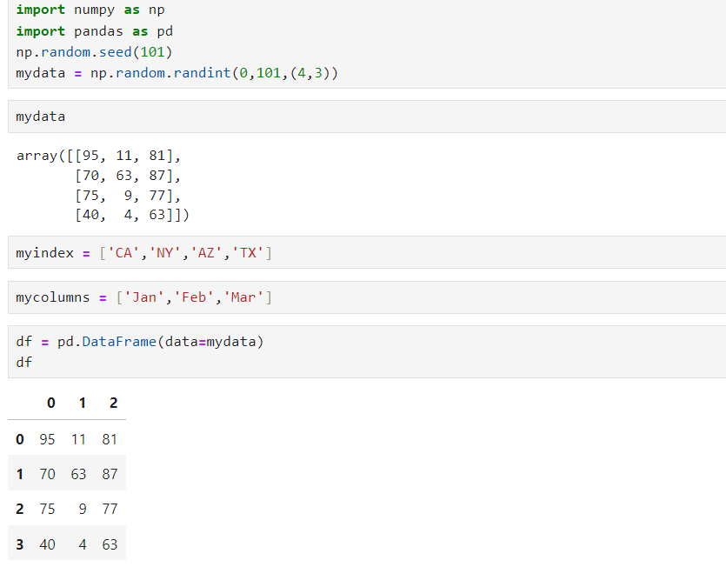

Slide 14
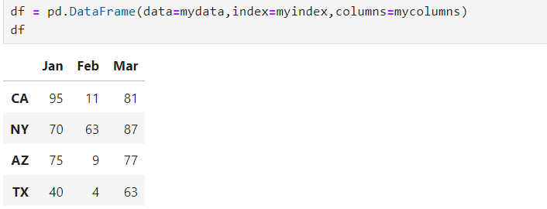
Adding index and column values

Slide 15
Understanding file paths
You have two options when reading a file with pandas:
If your .py file or .ipynb notebook is located in the exact same folder location as the .csv file you want to read, simply pass in the file name as a string, for example:
df = pd.read_csv(“some_file.csv”)

Slide 16
Pass in the entire file path if you are located in a different directory. The file path must be 100% correct in order for this to work. For example:
df = pd.read_csv("C:\\Users\\myself\\files\\some_file.csv")

Slide 17
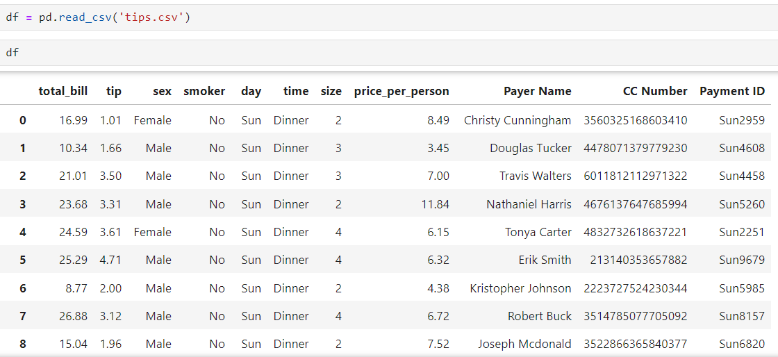
Example of DataFrame

Slide 18
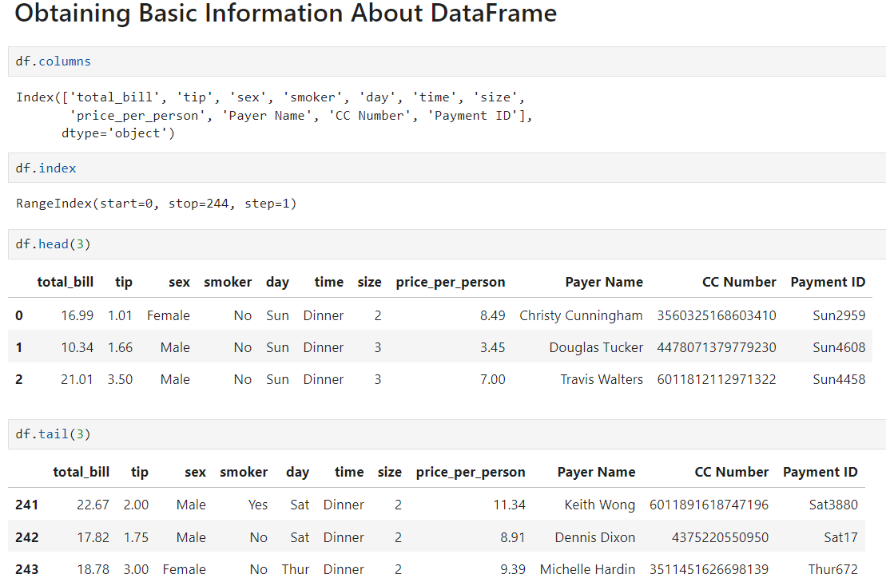

Slide 19
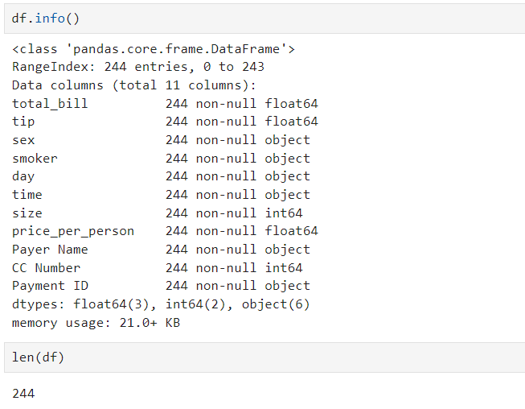

Slide 20
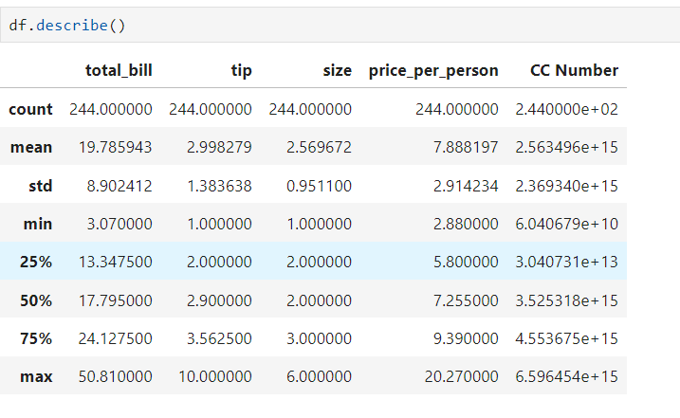

Slide 21
Operations on columns
Grab a single column : df['total_bill']
Grab multiple columns: df[['total_bill','tip']]
Create a new column:
df['tip_percentage'] = 100* df['tip'] / df['total_bill']
Adjust existing columns:
df['price_per_person'] = np.round(df['price_per_person'],2)

Slide 22
Drop columns: df = df.drop("tip_percentage",axis=1)
Above is an in place drop
Axis 0 means rows

Slide 23
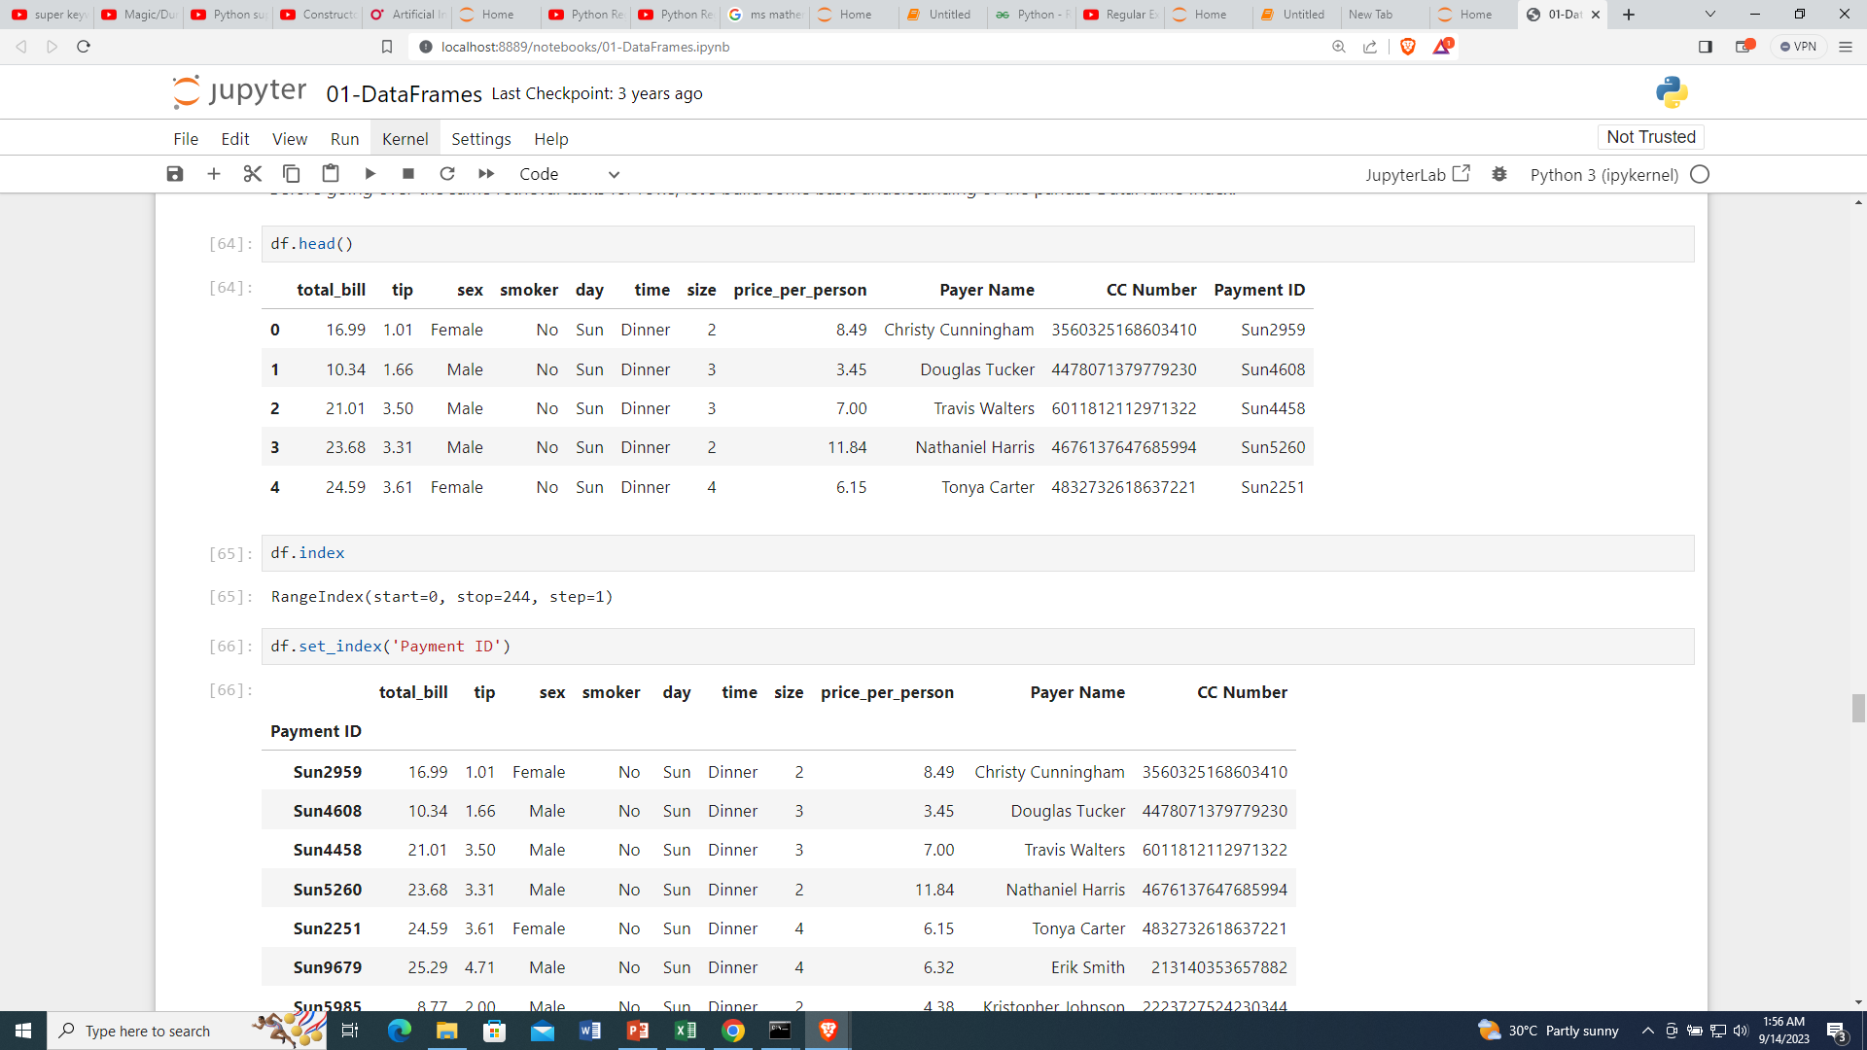
Set Index

Slide 24
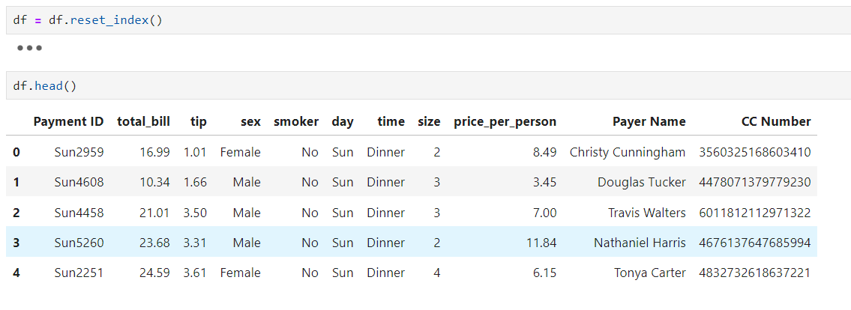
Reset Index

Slide 25
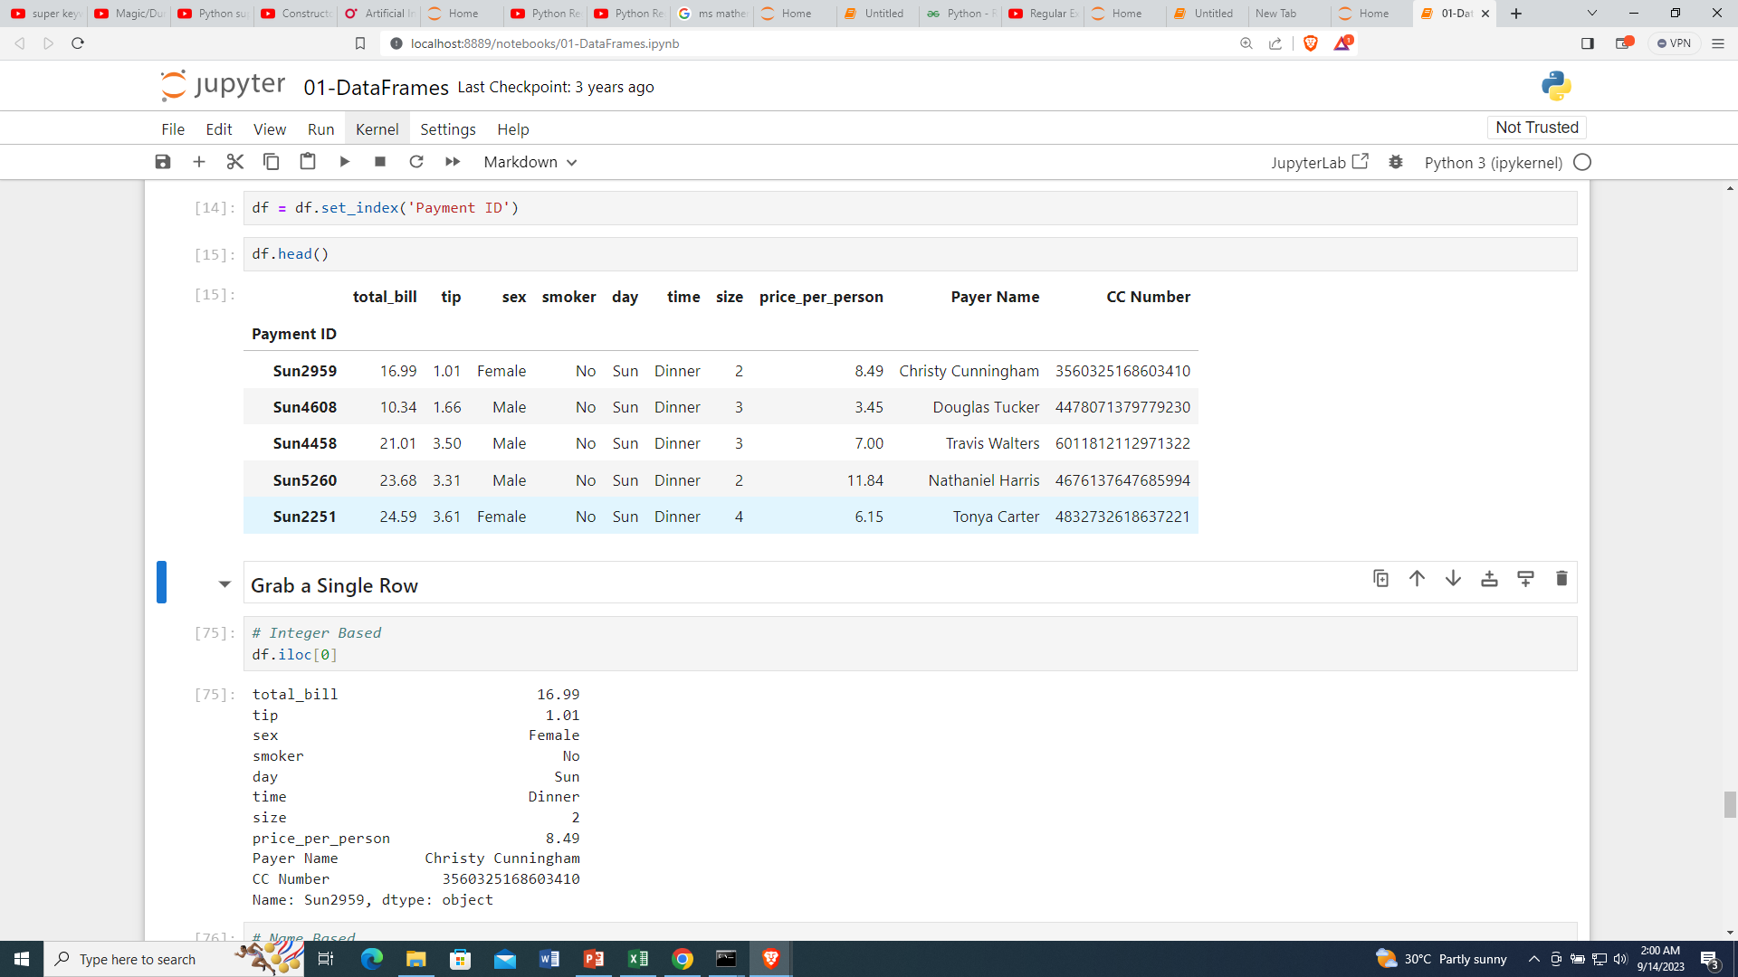
Grab a single row

Slide 26
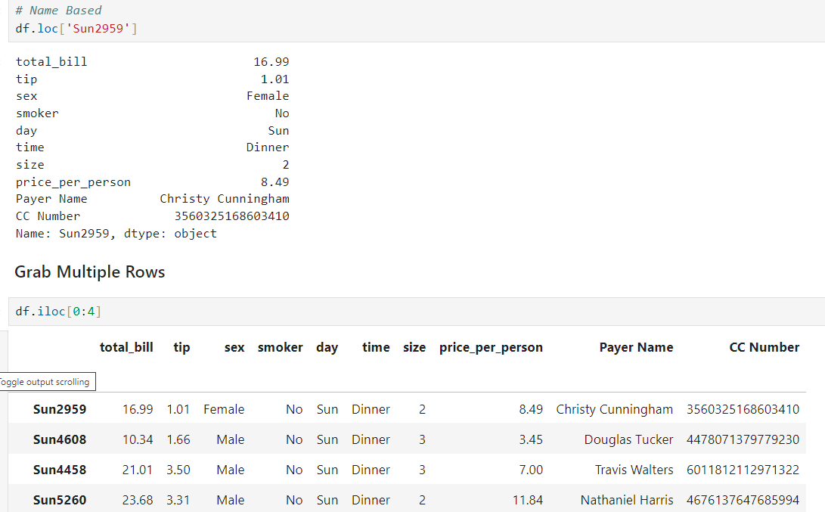
Grab multiple rows

Slide 27
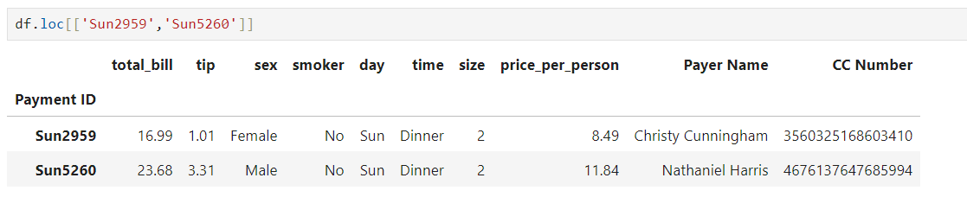
Loc method

Slide 28
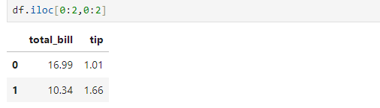
Loc/iLoc filtering
Syntax:
df.loc[Start_row: End_row , Start_column_:End_column]
df.loc[Start_row: End_row , Start_column_:End_column]
Extract the first two rows and columns

Slide 29
Concatenation

Slide 30
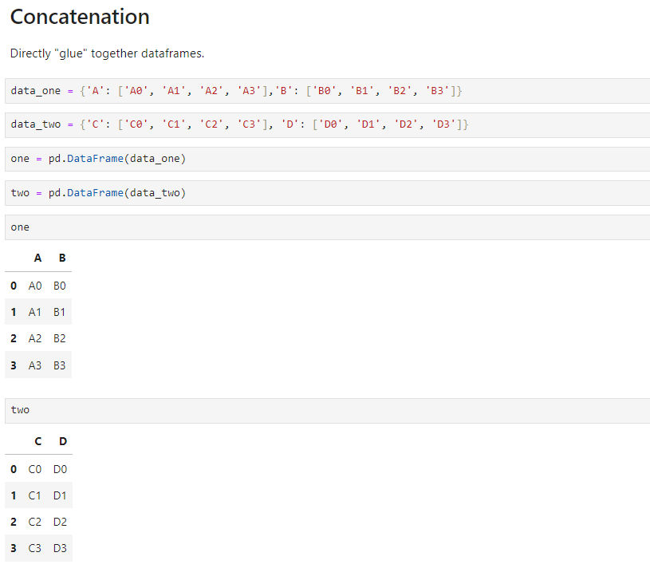

Slide 31
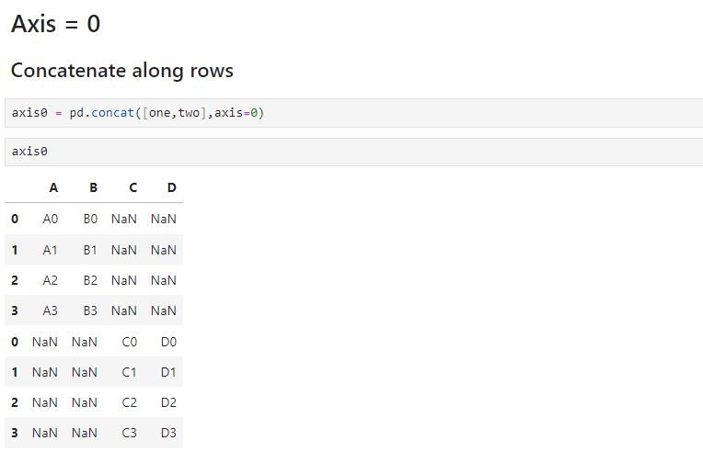

Slide 32
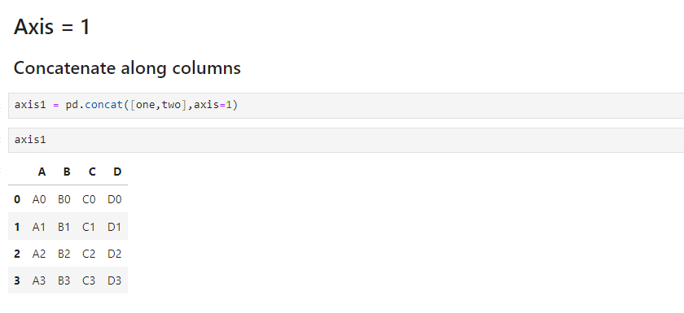

Slide 33
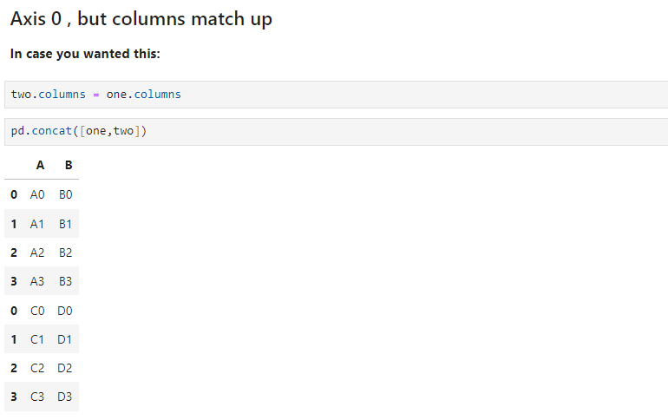

Slide 34
Merging

Slide 35
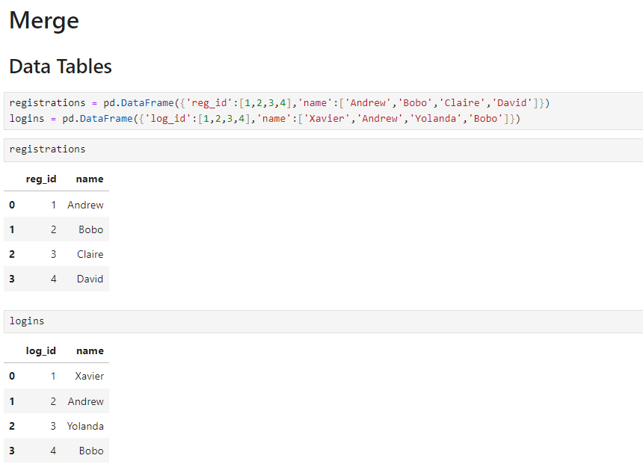

Slide 36
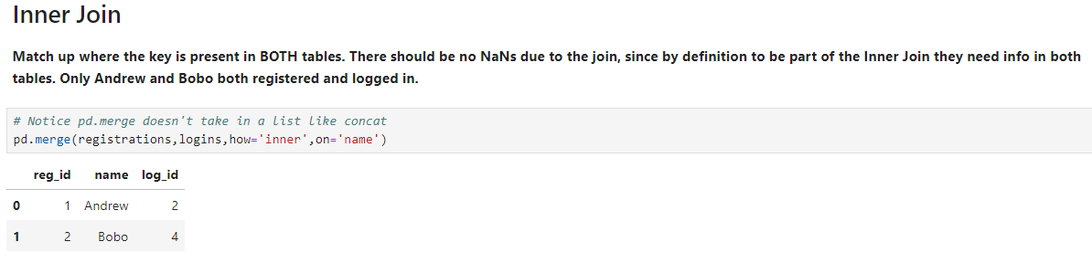

Slide 37
Missing data

Slide 38
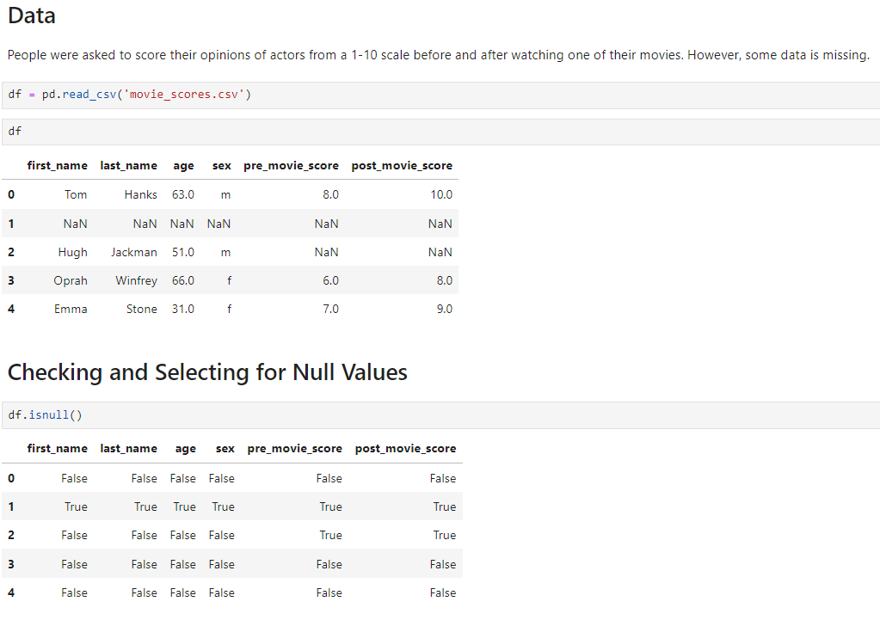

Slide 39
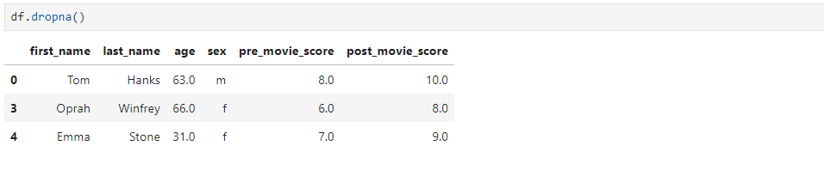

Slide 40
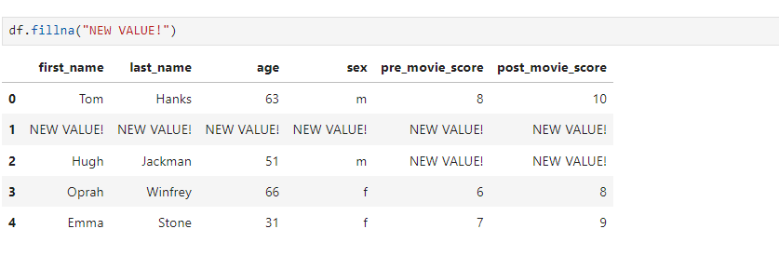

Slide 41
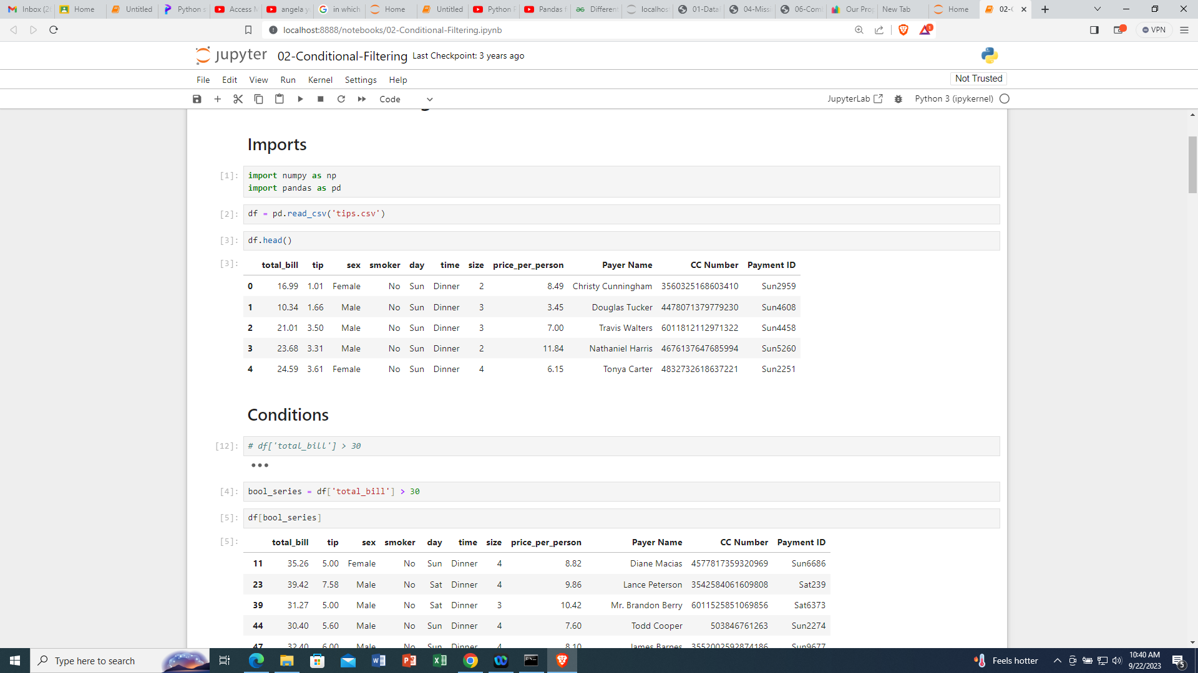

Slide 42
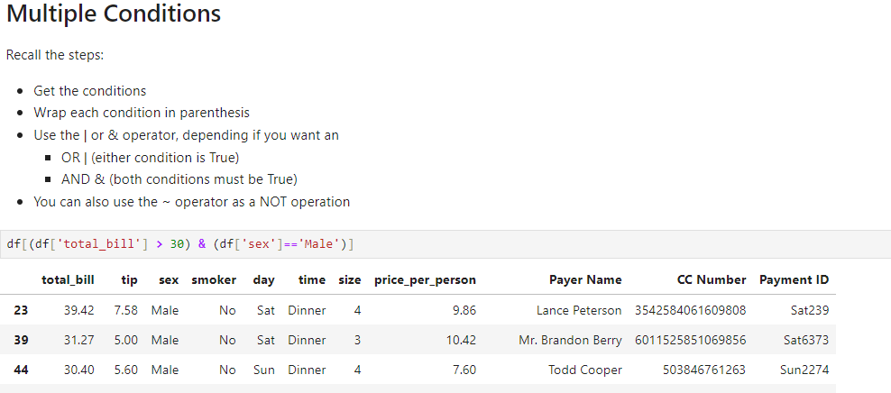

Slide 44
Group by

Slide 45
A groupby() operation allows us to examine data on a per category basis.
What is the average per group or category?

Slide 46
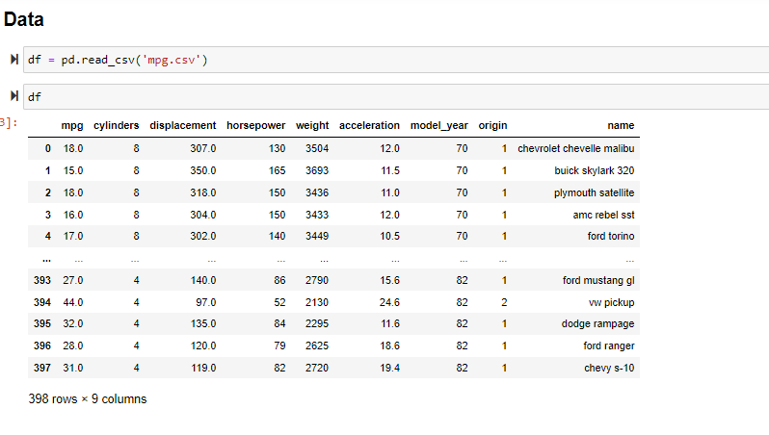

Slide 47
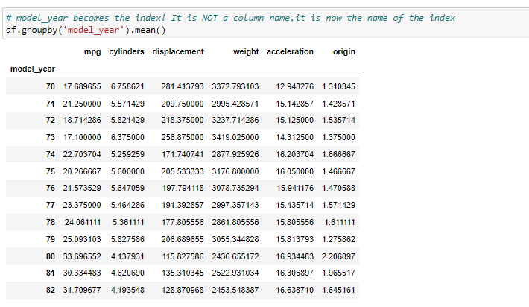

Slide 48
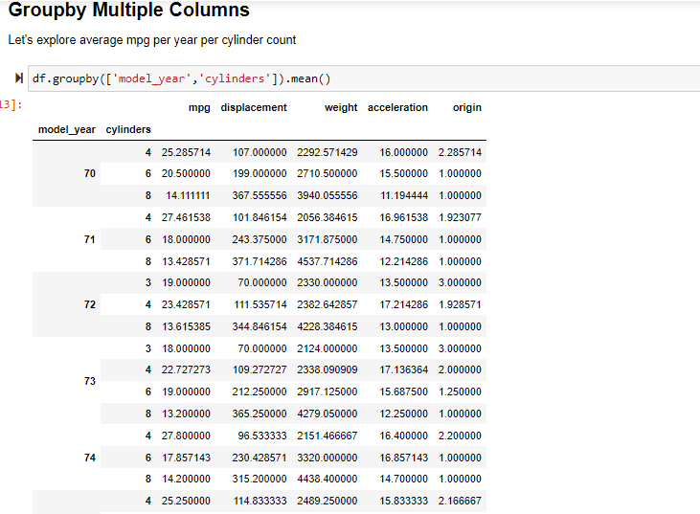

Slide 49
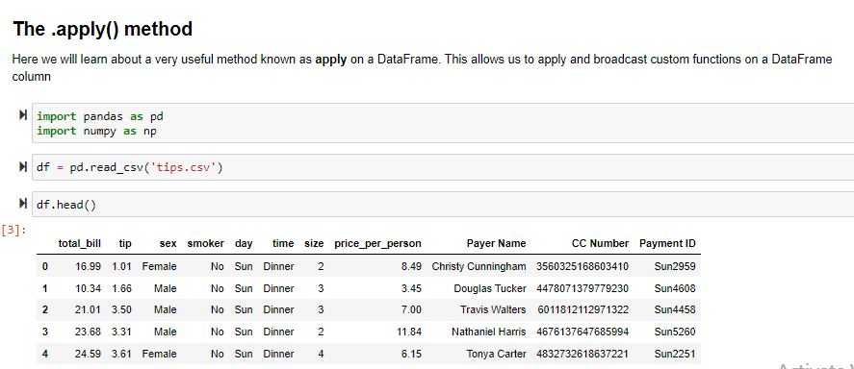
apply

Slide 50
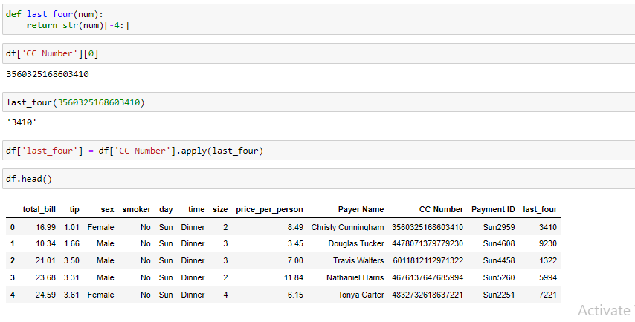

Slide 51
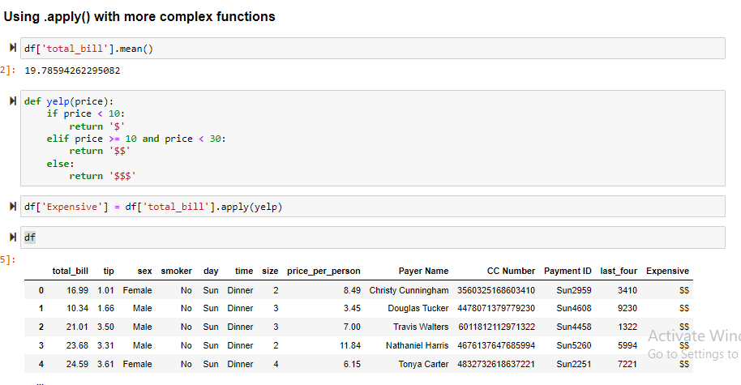

Slide 52
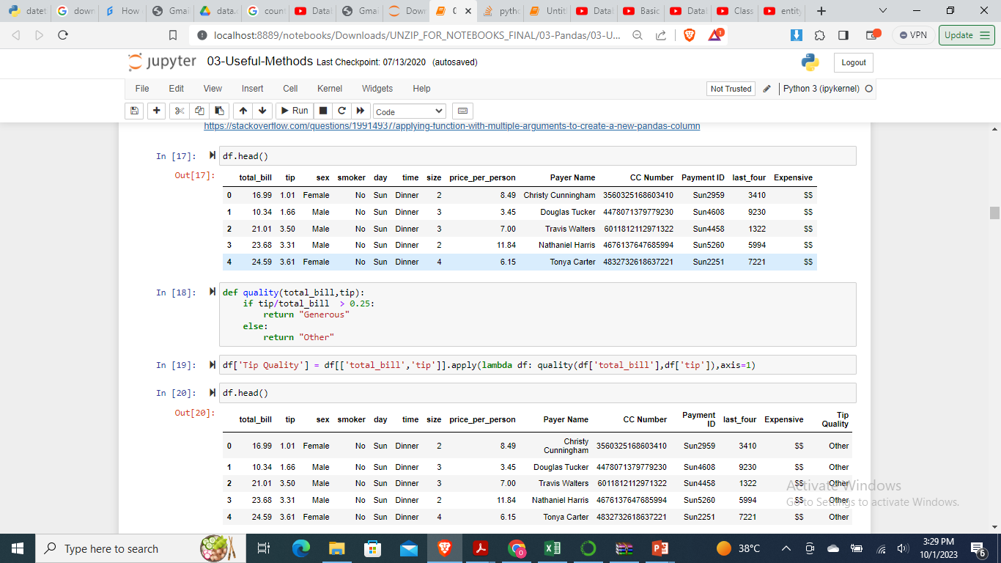
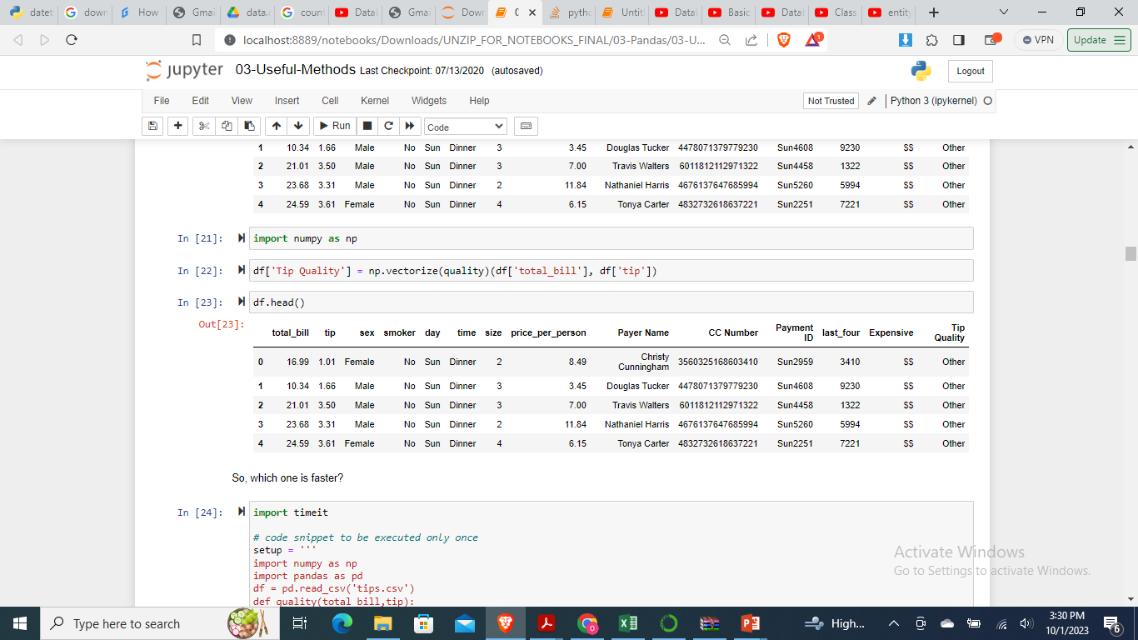

Slide 53
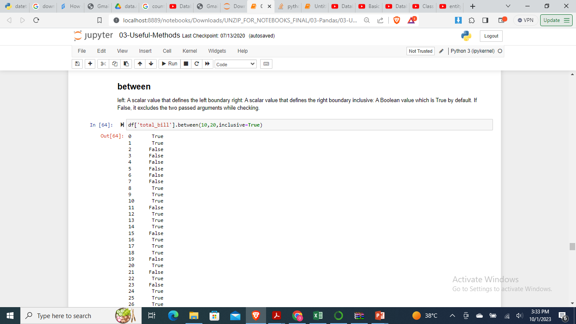
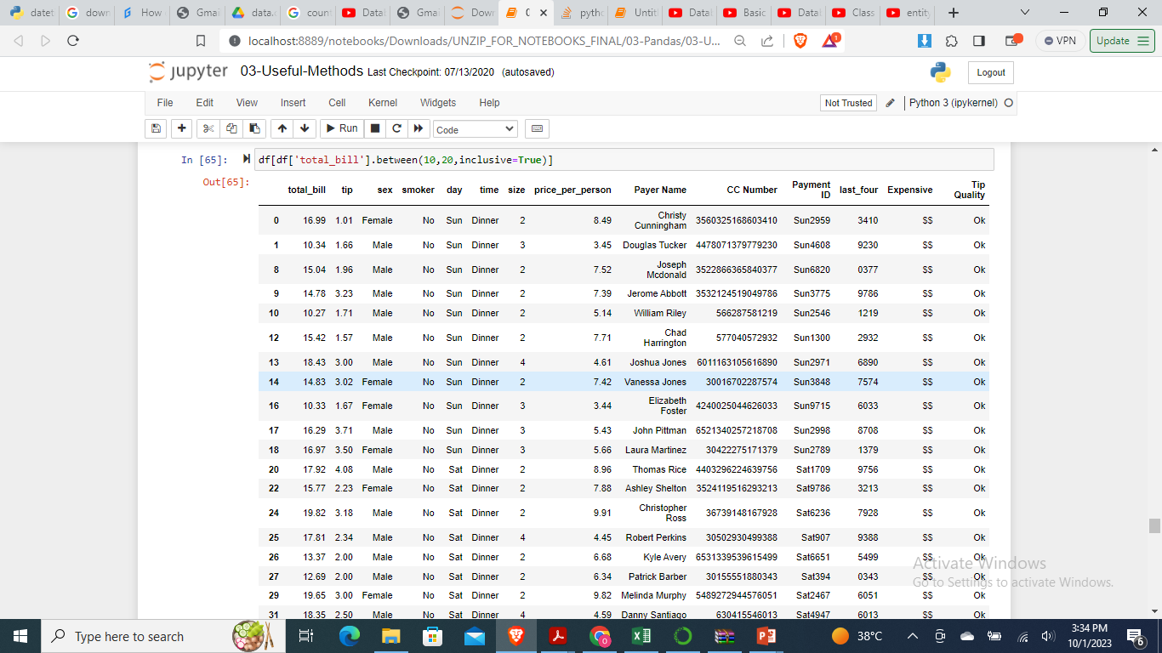

Slide 54
